Slide 1
DESIGN PATTERNS

Slide 2
BACKGROUND
Publish subscribe – communicate anywhere across an app.
Dependency injection – copy the pointers don’t create a new copy.
Façade – create an easy to use GUI.

Slide 3
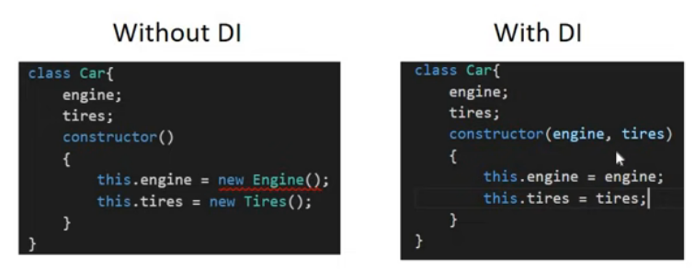
DEPENDENCY INJECTION
Copy the pointers don’t create a new copy.

